Slide 1
Data and Data Models
Lecture – 8
Sumita Narang

Slide 2
Objectives
Types of Data and Datasets
Data Quality
Epicycles of Data Analysis
Data Models
Model as expectation
Comparing models to reality
Reactions to Data
Refining our expectations
Six Types of the Questions
Characteristics of Good Question
Formal modelling
General Framework
Associational Analyses
Prediction Analyses

Slide 3
Modelling & Evaluation
1. Data Model Development & experiment framework setup
2. Data Model Evaluation & KPI Checks
Data Modelling based on training sets - At its core, a statistical model provides a description of how the world works and how the data were generated.
Read papers, research material to finalize the algorithmic approaches
Framework to feed in new data and test the models
Framework to change training data and retrain model based on new data sets as sliding window
3 main tasks involved -
Feature Engineering: Create data features from the raw data to facilitate model training
Model Training: Find the model that answers the question most accurately by comparing their success metrics
Determine if your model is suitable for production

Slide 4


1. Define Appropriately the Problem
The first, and one of the most critical things to do, is to find out what are the
inputs and the expected outputs. The following questions must be answered:
•
What is the main objective? What are we trying to predict?
•
What are the target features?
•
What is the input data? Is it available?
•
What kind of problem are we facing? Binary classification? Clustering?
•
What is the expected improvement?
•
What is the current status of the target feature?
•
How is going to be measured the target feature?
5
BITS Pilani, Pilani Campus

Slide 5
2. Developing a Benchmark
Model
Benchmark Model
The goal in this step of the process is to develop a benchmark model that
serves us as a baseline, upon we’ll measure the performance of a better and
more attuned algorithm.
Benchmarking requires experiments to be comparable, measurable, and
reproducible. It is important to emphasize on the reproducible part of the last
statement. Now a day’s data science libraries perform random splits of data,
this randomness must be consistent through all runs. Most random generators
support setting a seed for this purpose. In Python we will use the random.seed
method from the random package.
Null Model Bayes rate model
Normal Model
17
BITS Pilani, Pilani Campus

Slide 6
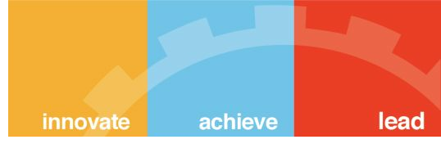




Ideal models to calibrate against
Null Model
A null model is the best model of a very simple form
you’re trying to outperform. The two most typical null
model choices are a model that is a single constant
(returns the same answer for all situations) or a model
that is independent (doesn’t record any important
relation or interaction between inputs and outputs).
We use null models to lower-bound desired
performance, so we usually compare to a best null
model.
17
BITS Pilani, Pilani Campus

Slide 7
Ideal models to calibrate against
P(A | B) = (P(B | A) * P(A)) / P(B)
Bayes rate model
The Bayes Optimal Classifier is a probabilistic model that makes the most probable prediction for a new example. A Bayes rate model (also sometimes called a saturated model) is a best possible model given the data at hand.
The Bayes rate model is the perfect model and it only makes mistakes when there are multiple examples with the exact same set of known facts (same xs) but different outcomes (different ys).
It isn’t always practical to construct the Bayes rate model, but we invoke it as an upper bound on a model evaluation score.
P(vj | D) = sum {h in H} P(vj | hi) * P(hi | D)
Where vj is a new instance to be classified, H is the set of hypotheses for classifying the instance, hi is a given hypothesis, P(vj | hi) is the posterior probability for vi given hypothesis hi, and P(hi | D) is the posterior probability of the hypothesis hi given the data D.
https://machinelearningmastery.com/bayes-optimal-classifier/
18
BITS Pilani, Pilani Campus

Slide 8
Ideal models to calibrate against
Normal Model
This model says that the randomness in a set of data can be explained by the Normal distribution, or a bell-shaped curve. The Normal distribution is fully specified by two parameters—the mean and the standard deviation.

Slide 9
3. Comparing Model Expectation to Reality
We may be very proud of developing our statistical model,
but ultimately its usefulness will depend on how closely it
mirrors the data we collect in the real world.
Price Survey Data with Normal Distribution

Slide 10
Choose a Measure of Success
“If you can’t measure it you can’t improve it”.
If you want to control something it should be observable, and in order to
achieve success, it is essential to define what is considered success: Maybe
precision? accuracy? Customer-retention rate?
This measure should be directly aligned with the higher level goals of the
business at hand. And it is also directly related with the kind of problem we are
facing:
•
Regression problems use certain evaluation metrics such as mean squared
error (MSE).
•
Classification problems use evaluation metrics as precision, accuracy and
recall.
8
BITS Pilani, Pilani Campus

Slide 11
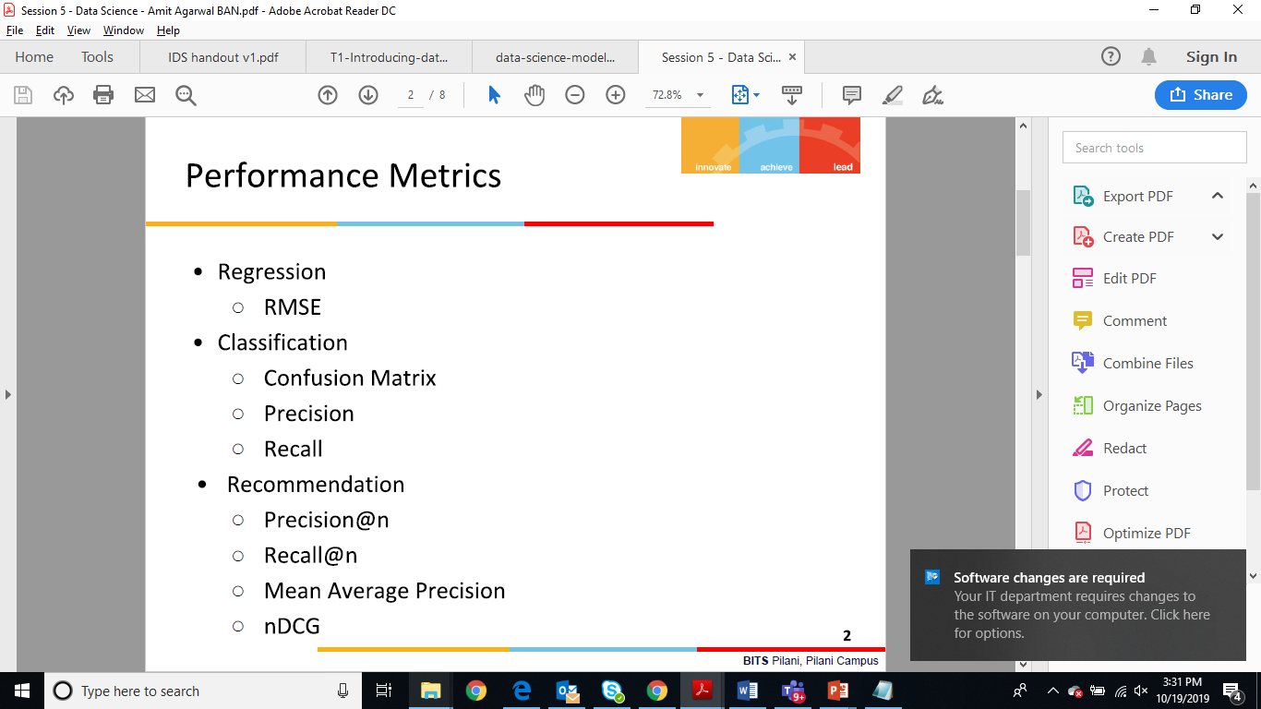
Model Evaluation Metrics
Performance Metrics vary based on type of models i.e. Classification Models, Clustering Models, Regression Models.
https://www.analyticsvidhya.com/blog/2019/08/11-important-model-evaluation-error-metrics/

Slide 12
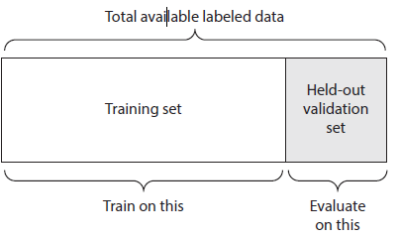
Setting an Evaluation Protocol
Maintaining a Hold Out Validation Set
This method consists on setting apart some portion of the data as the test set.
The process would be to train the model with the remaining fraction of the data,
tuning its parameters with the validation set and finally evaluating its
performance on the test set.
The reason to split data in three parts is to avoid information leaks. The main
inconvenient of this method is that if there is little data available, the validation
and test sets will contain so few samples that the tuning and evaluation
processes of the model will not be effective.
9
BITS Pilani, Pilani Campus

Slide 13
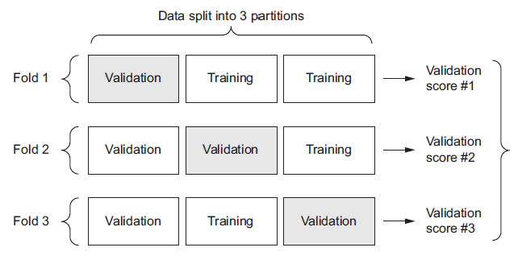
Setting an Evaluation Protocol
K-Fold Validation
K-Fold consists in splitting the data into K partitions of equal size. For each
partition i, the model is trained with the remaining K-1 partitions and it is
evaluated on partition i.
The final score is the average of the K scored obtained. This technique is
specially helpful when the performance of the model is significantly different
from the train-test split.
10
BITS Pilani, Pilani Campus

Slide 14
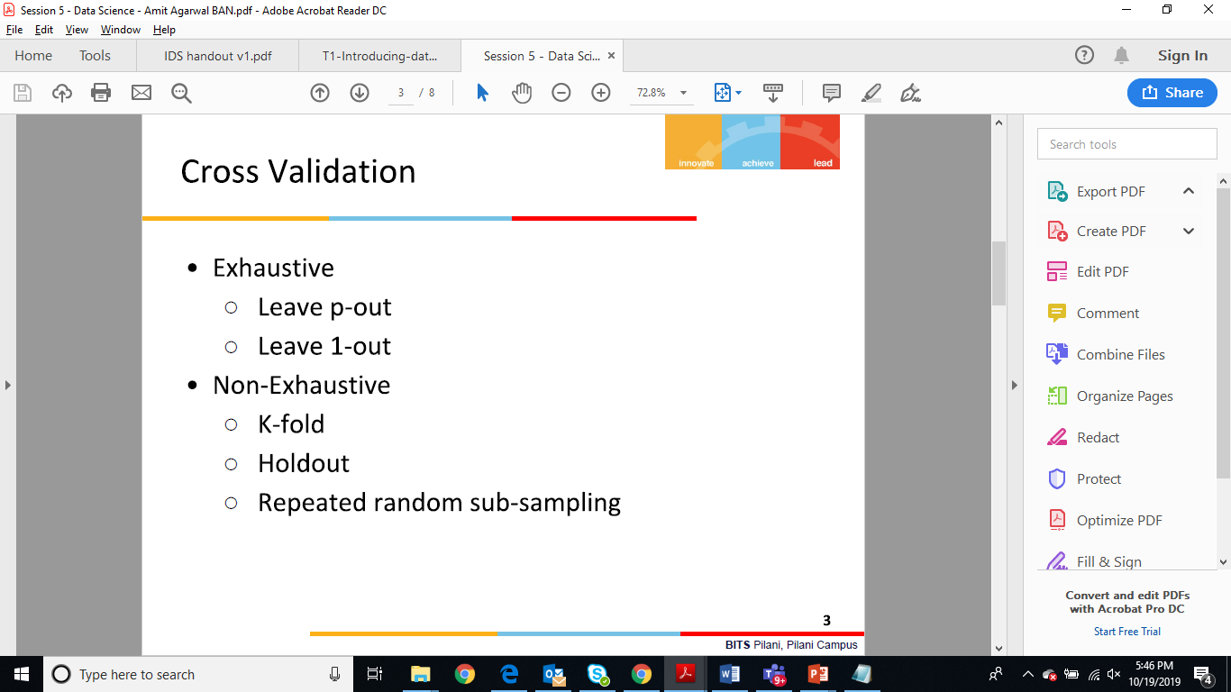
Setting an Evaluation Protocol
Iterated K-Fold Validation with Shuffling
It consist on applying K-Fold validation several times and shuffling the data
every time before splitting it into K partitions. The Final score is the average of
the scores obtained at the end of each run of K-Fold validation.
This method can be very computationally expensive, as the number of trained
and evaluating models would be I x K times. Being I the number of iterations
and K the number of partitions.
11
BITS Pilani, Pilani Campus

Slide 15
4. Reacting to Data: Refining Our
Expectations
Okay, so the model and the data don’t match very well, as
was indicated by the histogram above. So what do do? Well, we can either
1. Get a different model; or
2. Get different data
Price Survey Data with Gamma Distribution

Slide 16

Validating models
Identifying common model problems
Bias - Systematic Error
Variance - Undesirable (but non-systematic) distance
between predictions and actual values.
Overfit
Nonsignificance: A model that appears to show an
important relation when in fact the relation may not hold
in the general population, or equally good predictions
can be made without the relation.
29
BITS Pilani, Pilani Campus

Slide 17

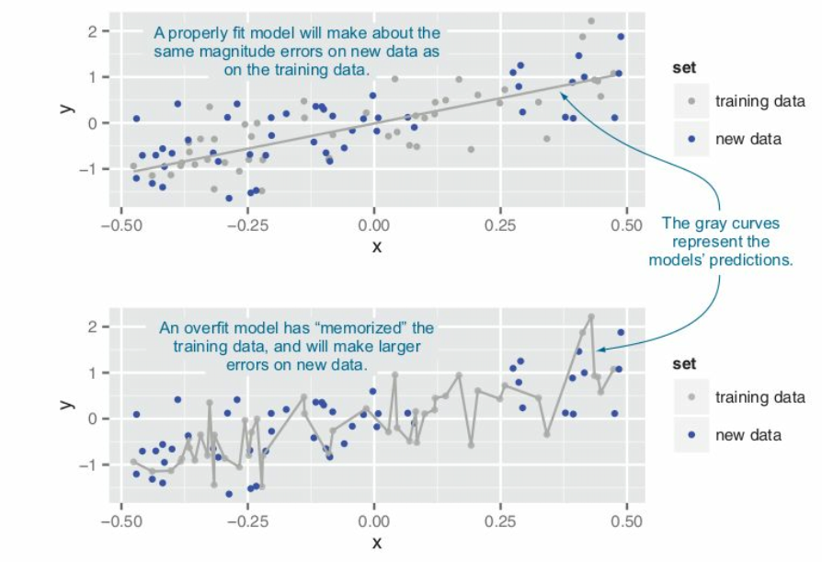
Validating models
30
BITS Pilani, Pilani Campus

Slide 18
Ensuring model quality
Testing On Held - Out Data
k-fold cross-validation
The idea behind k-fold cross-validation is to repeat the construction
of the model on different subsets of the available training data and
then evaluate the model only on data not seen during construction.
This is an attempt to simulate the performance of the model on
unseen future data.
Significance Testing
“What is your p-value?”
31
BITS Pilani, Pilani Campus

Slide 19
Balancing Bias & Variance to Control Errors in Machine Learning
https://towardsdatascience.com/balancing-bias-and-variance-to-control-errors-in-machine-learning-16ced95724db
Y = f(X) + e
Estimation of this relation or f(X) is known as statistical learning. On general, we won’t be able to make a perfect estimate of f(X), and this gives rise to an error term, known as reducible error. The accuracy of the model can be improved by making a more accurate estimate of f(X) and therefore reducing the reducible error. But, even if we make a 100% accurate estimate of f(X), our model won’t be error free, this is known as irreducible error(e in the above equation).
The quantity e may contain unmeasured variables that are useful in predicting Y : since we don’t measure them, f cannot use them for its prediction. The quantity e may also contain unmeasurable variation.
Bias
Bias refers to the error that is introduced by approximating a real-life problem, which may be extremely complicated, by a much simpler model. So, if the true relation is complex and you try to use linear regression, then it will undoubtedly result in some bias in the estimation of f(X). No matter how many observations you have, it is impossible to produce an accurate prediction if you are using a restrictive/ simple algorithm, when the true relation is highly complex.
Variance
Variance refers to the amount by which your estimate of f(X) would change if we estimated it using a diﬀerent training data set. Since the training data is used to ﬁt the statistical learning method, diﬀerent training data sets will result in a diﬀerent estimation. But ideally the estimate for f(X) should not vary too much between training sets. However, if a method has high variance then small changes in the training data can result in large changes in f(X).
A general rule is that, as a statistical method tries to match data points more closely or when a more flexible method is used, the bias reduces, but variance increases.
In order to minimize the expected test error, we need to select a statistical learning method that simultaneously achieves low variance and low bias.

Slide 20
When Do We Stop Training & Model fitment process?
Six Types of the Questions
Are you out of data?
Iterative data analysis will eventually begin to raise questions that simply cannot be answered with the data at hand.
Another situation in which you may find yourself seeking out more data is when you’ve actually completed the data analysis and come to satisfactory results, usually some interesting finding. Then, it can be very important to try to replicate whatever you’ve found using a different, possibly independent, dataset.
Do you have enough evidence to make a decision?
It’s important to always keep in mind the purpose of the data analysis as you go along because you may over or under-invest resources in the analysis if the analysis is not attuned to the ultimate goal.
The question of whether you have enough evidence depends on factors specific to the application at hand and your personal situation with respect to costs and benefits.

Slide 21
Six Types of the Questions
Can you place your results in any larger context?
Are results working on larger dataset in a bigger context, matching with past observations
Is model working well on multiple variations in the data or on different data sets
Are you out of time?
project timelines are approaching
Is model able to give results in define application SLAs Is model running for hours to give results,
Is your model overfitting?
Is your model able to handle noisy, messy data, outliers?

Slide 22
Formal Modelling
7.2 General Framework
Source Courtesy: Some of the contents of this PPT are sourced from materials provided by publishers of prescribed books

Slide 23
General Framework
1. Setting expectations. Setting expectations comes in the form of developing a primary model that represents. your best sense of what provides the answer to your question. This model is chosen based on whatever information you have currently available.
2. Collecting Information. Once the primary model is set, we will want to create a set of secondary models that challenge the primary model in some way. We will discuss examples of what this means below.
3. Revising expectations. If our secondary models are successful in challenging our primary model and put the primary model’s conclusions in some doubt, then we may need to adjust or modify the primary model to better reflect what we have learned from the secondary models.

Slide 24
Primary Model
It’s often useful to start with a primary model. This model will likely be derived from any exploratory analyses that you have already conducted and will serve as the lead candidate for something that succinctly summarizes your results and matches your expectations. It’s important to realize that at any given moment in a data analysis, the primary model is not necessarily the final model.
Through the iterative process of formal modeling, you may decide that a different model is better suited as the primary model. This is okay, and is all part of the process of setting expectations, collecting information, and refining expectations based on the data.

Slide 25
Secondary models
Once you have decided on a primary model, you will then typically develop a series of secondary models. The purpose of these models is to test the legitimacy and robustness of your primary model and potentially generate evidence against your primary model. If the secondary models are successful in generating evidence that refutes the conclusions of your primary model, then you may need to revisit the primary model and whether its conclusions are still reasonable.

Slide 26
Association Analysis
There are three classes of variables that are important to think about in an associational analysis.
1. Outcome. The outcome is the feature of your dataset that is thought to change along with your key predictor. Even if you are not asking a causal or mechanistic question, so you don’t necessarily believe that the outcome responds to changes in the key predictor, an outcome still needs to be defined for most formal modeling approaches.
2. Key predictor. Often for associational analyses there is one key predictor of interest (there may be a few of them). We want to know how the outcome changes with this key predictor. However, our understanding of that relationship may be challenged by the presence of potential confounders.
3. Potential confounders. This is a large class of predictors that are both related to the key predictor and the outcome. It’s important to have a good understanding what these are and whether they are available in your dataset. If a key confounder is not available in the dataset, sometimes there will be a proxy that is related to that key confounder that can be substituted instead.
The basic form of a model in an associational analysis will be –

Slide 27

Linear Regression
https://towardsdatascience.com/regularization-in-machine-learning-76441ddcf99a
This is a form of regression, that constrains/ regularizes or shrinks the coefficient estimates towards zero. In other words, this technique discourages learning a more complex or flexible model, so as to avoid the risk of overfitting.
A simple relation for linear regression looks like this. Here Y represents the learned relation and β represents the coefficient estimates for different variables or predictors(X).
Y ≈ β0 + β1X1 + β2X2 + …+ βpXp
The fitting procedure involves a loss function, known as residual sum of squares or RSS. The coefficients are chosen, such that they minimize this loss function. Now, this will adjust the coefficients based on your training data. If there is noise in the training data, then the estimated coefficients won’t generalize well to the future data. This is where regularization comes in and shrinks or regularizes these learned estimates towards zero.

Slide 28


Regularization
Ridge Regression
Above image shows ridge regression, where the RSS is modified by adding the shrinkage quantity. Now, the coefficients are estimated by minimizing this function. Here, λ is the tuning parameter that decides how much we want to penalize the flexibility of our model. The increase in flexibility of a model is represented by increase in its coefficients, and if we want to minimize the above function, then these coefficients need to be small. This is how the Ridge regression technique prevents coefficients from rising too high.
Lasso Regression
What does Regularization achieve?
A standard least squares model tends to have some variance in it, i.e. this model won’t generalize well for a data set different than its training data. Regularization, significantly reduces the variance of the model, without substantial increase in its bias. So the tuning parameter λ, used in the regularization techniques described above, controls the impact on bias and variance. As the value of λ rises, it reduces the value of coefficients and thus reducing the variance. Till a point, this increase in λ is beneficial as it is only reducing the variance(hence avoiding overfitting), without loosing any important properties in the data. But after certain value, the model starts loosing important properties, giving rise to bias in the model and thus underfitting. Therefore, the value of λ should be carefully selected.

Slide 29
Predictive Modelling
Predictive modeling refers to the task of building a model for the target variable as a function of the explanatory variables. There are two types of predictive modeling tasks:
Classification, which is used for discrete target variables, and regression, which is used for continuous target variables. For example, predicting whether a Web user will make a purchase at an online bookstore is a classification task because the target variable is binary-valued.
On the other hand, forecasting the future price of a stock is a regression task because price is a continuous-valued attribute. The goal of both tasks is to learn a model that minimizes the error between the predicted and true values of the target variable.
Predictive modeling can be used to identify customers that will respond to a marketing campaign, predict disturbances in the Earth's ecosystem, or judge whether a patient has a particular disease based on the results of medical tests.

Slide 30
Classification Predictive Modelling Techniques
In classification problems, we use two types of algorithms (dependent on the kind of output it creates):
Class output: Algorithms like SVM and KNN create a class output. For instance, in a binary classification problem, the outputs will be either 0 or 1. However, today we have algorithms which can convert these class outputs to probability. But these algorithms are not well accepted by the statistics community.
Probability output: Algorithms like Logistic Regression, Random Forest, Gradient Boosting, Adaboost etc. give probability outputs. Converting probability outputs to class output is just a matter of creating a threshold probability.
Classification Algorithms vs Clustering Algorithms
In clustering, the idea is not to predict the target class as in classification, it’s more ever trying to group the similar kind of things by considering the most satisfied condition, all the items in the same group should be similar and no two different group items should not be similar.

Slide 31
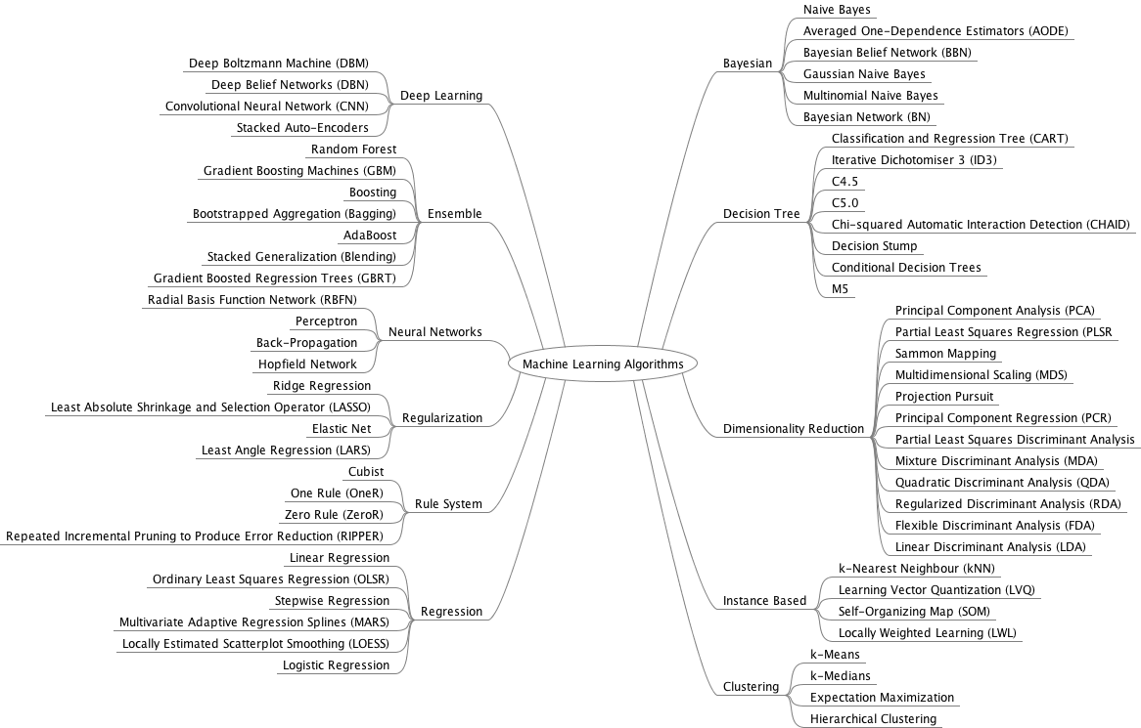
ML Models
summary of ML models, Source
BITS Pilani, Pilani Campus

Slide 32
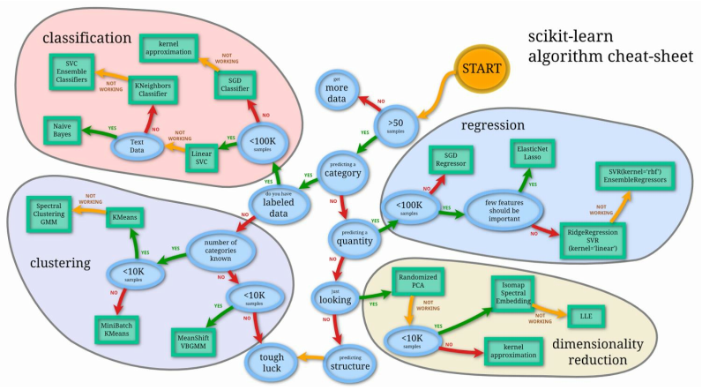
Algorithms
BITS Pilani, Pilani Campus

Slide 33
Model - Tuning its
Hyperparameters
Finding a Good Model
One of the most common methods for finding a good model is cross validation.
In cross validation we will set:
•
A number of folds in which we will split our data.
•
A scoring method (that will vary depending on the problem’s nature —
regression, classification…).
•
Some appropriate algorithms that we want to check.
We’ll pass our dataset to our cross validation score function and get the model
that yielded the best score. That will be the one that we will optimize, tunning its
hyperparameters accordingly.
18
BITS Pilani, Pilani Campus

Slide 34
Model - Tuning its
Hyperparameters
# Test Options and Evaluation Metrics
num_folds = 10
scoring = "neg_mean_squared_error"
# Spot Check Algorithms
models = []
models.append(('LR', LinearRegression()))
models.append(('LASSO', Lasso()))
models.append(('EN', ElasticNet()))
models.append(('KNN', KNeighborsRegressor()))
models.append(('CART', DecisionTreeRegressor()))
models.append(('SVR', SVR()))
results = []
names = []
for name, model in models:
kfold = KFold(n_splits=num_folds, random_state=seed)
cv_results = cross_val_score(model, X_train, y_train, cv=kfold, scoring=scoring)
results.append(cv_results)
names.append(name)
msg = "%s: %f (%f)" % (name, cv_results.mean(), cv_results.std())
print(msg)
19
BITS Pilani, Pilani Campus

Slide 35
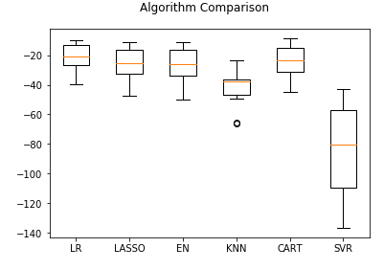
Model - Tuning its
Hyperparameters
# Compare Algorithms
fig = pyplot.figure()
fig.suptitle('Algorithm Comparison')
ax = fig.add_subplot(111)
pyplot.boxplot(results)
ax.set_xticklabels(names)
pyplot.show()
20
BITS Pilani, Pilani Campus

Slide 36
Exercise towards
Applications
Implementation of Modeling for Customer Churn in Telecom Industry
Data Set:
https://www.kaggle.com/becksddf/churn-in-telecoms-dataset
Implementation of Modeling for Health Industry – Heart Diseases
Data Set:
https://www.kaggle.com/ronitf/heart-disease-uci
BITS Pilani, Pilani Campus

Slide 37
References
https://www.bouvet.no/bouvet-deler/roles-in-a-data-science-project
https://www.altexsoft.com/blog/datascience/how-to-structure-data-science-team-key-models-and-roles/
https://www.quora.com/What-is-the-life-cycle-of-a-data-science-project
https://towardsdatascience.com/5-steps-of-a-data-science-project-lifecycle-26c50372b492
https://www.dezyre.com/article/life-cycle-of-a-data-science-project/270
https://www.slideshare.net/priyansakthi/methods-of-data-collection-16037781
https://www.questionpro.com/blog/qualitative-data/
https://surfstat.anu.edu.au/surfstat-home/1-1-1.html
https://www.mymarketresearchmethods.com/types-of-data-nominal-ordinal-interval-ratio/
https://www.coursera.org/learn/decision-making

